Slide 1

Employee Analysis
This analysis provides a comprehensive overview of a company's employee data, including total employees, current employees, employee exits, job titles, departments, and business units.
by Kuburat Aliyu
Notes:
Hello,
I am Aliyu Kuburat and this is a Project report on Employee /HR Analysis

Slide 2
Table of Contents
Introduction
Problem Statement
Objective
Employee Overview Analysis
Summary of Findings
Recommendations
Limitations
Notes:
Here is what the analysis is about.

Slide 3
Introduction
In today's competitive business landscape, understanding the dynamics of an organization's workforce is critical for sustainable growth and success. This report presents a comprehensive analysis of employee data. Limited, focusing on various dimensions such as job titles, departments, business units, gender, ethnicity, age distribution, salary, bonuses, and geographical distribution. By examining these factors, we aim to provide valuable insights that can inform strategic decisions related to hiring, retention, compensation, and diversity initiatives.
Notes:
This report comprehensively analyses the company's workforce demographics, hiring patterns, employee exits, compensation trends, and geographic distribution. By leveraging the available data, this analysis aims to shed light on the current state of the company's human capital and identify areas for potential improvement.

Slide 4

Problem Statement
The company's workforce dynamics are complex and require a deeper understanding to optimize retention, compensation practices, and overall talent management strategies. This analysis aims to address the following key questions:
How is the company's workforce structured in terms of job titles, departments, and
business units?
What are the trends in hiring and employee exits across departments and ethnicities?
Is there a gender or ethnic disparity in salaries and bonuses?
How is the workforce geographically distributed, and are there any regional trends in
compensation or turnover?
What are the limitations of the available data, and how could future analyses be improved?
Notes:
Problem Statement
A company is experiencing growth and expansion, with a deep understanding of its workforce dynamics. The company has observed variations in hiring and exit rates, salary distributions, bonuses, and demographic compositions across different departments and business units. These variations raise several critical questions:
1) What are the trends and patterns in employee hiring and exits over time?
2) How do job titles, departments, and business units influence employee distribution and turnover?
3) What are the demographic distributions in terms of gender, ethnicity, and age, and how do these factors impact salary and bonus allocations?
4) How does geographic location influence workforce composition and compensation?

Slide 5
Objectives
This analysis aims to achieve the following objectives:
Identify areas of strength and weakness in the company's workforce demographics
and composition.
Gain insights into hiring and exit trends to inform talent acquisition and
retention strategies.
Analyze potential salary and bonus disparities across different genders and ethnicities.
Understand the geographic distribution of the workforce and explore potential
regional trends.
Identify limitations in the current data and recommend strategies for future data
collection and analysis to gain a more comprehensive picture of the workforce dynamics.
Notes:
The primary objective of this report is to provide a detailed analysis of the employee data to uncover key insights and trends. Specifically, we aim to:
Analyze employees' overall composition and distribution over time, including current and exited employees.
To examine the distribution of job titles, departments, and business units, and identify trends in hiring and exits.
Investigate the demographic distributions of gender and ethnicity, and assess their impact on salary and bonus allocations.
Explore the geographical distribution of employees and analyze the implications of location on workforce dynamics.
To assess the age distribution of employees and its correlation with departmental and organizational trends.
Provide actionable recommendations to address identified issues and support strategic HR initiatives, including improving employee retention, ensuring equitable compensation, and fostering diversity and inclusion.

Slide 6
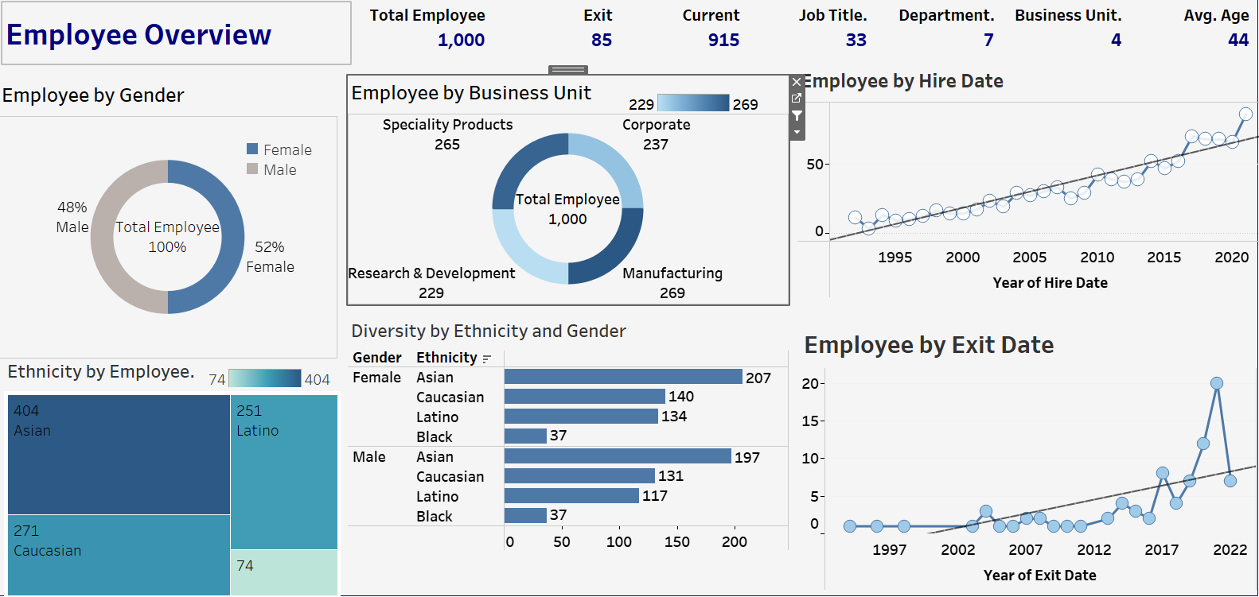
Notes:
• Total employees over time is 1,000 (915 current, 85 exited)
• 33 job titles across 7 departments and 4 business units
• Average department size: 44 employees

Slide 7
Hire and Exit Date Analysis
2021
2022
Highest Hires
Lower Exits
Employee hire trends peaked in 2021.
Employee exit trends declined in 2022 after a high in 2021.
The analysis shows that the number of employee exits was highest in the Human Resources and Finance departments, while the Account department had the lowest number of exits. Across business units, the Specialty Products and Research & Development groups saw the most exits, while Corporate and Manufacturing had lower exit numbers.
Notes:
• Yearly exits: At least one exit per year except from 2000-2002, with the highest exits in 2021 with 20 and a decrease in 2022 (7)

Slide 8
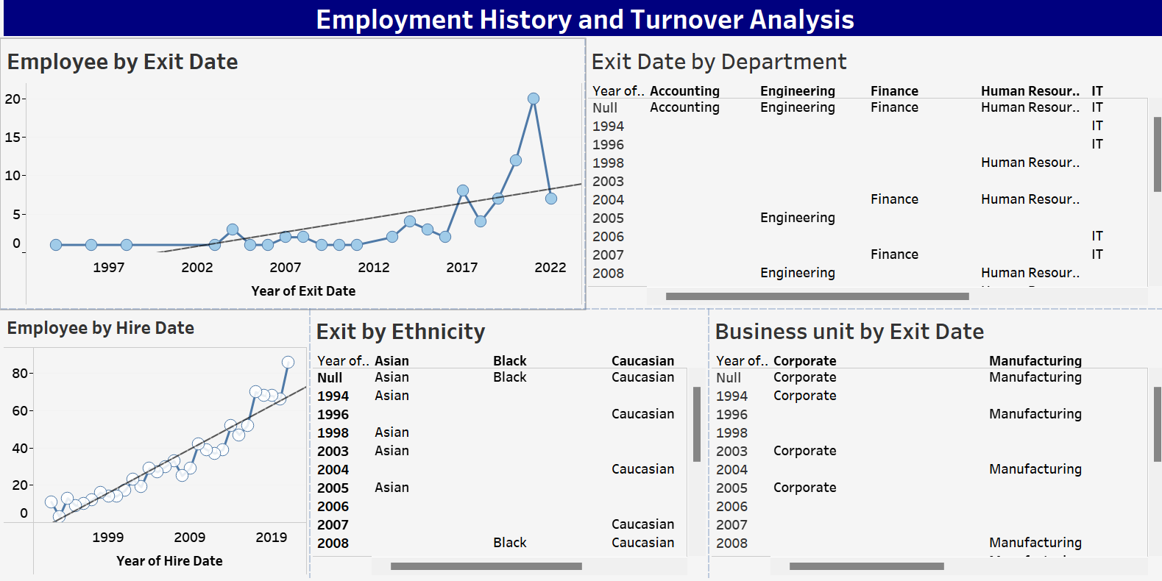
Notes:
The analysis shows a continuous upward trend in hiring, with the highest count in 2021 indicating company expansion
Human Resources and Finance have the highest exit rates, while Accounting has the lowest exits.
More exits in Specialty Products and Research & Development compared to Corporate and Manufacturing

Slide 9
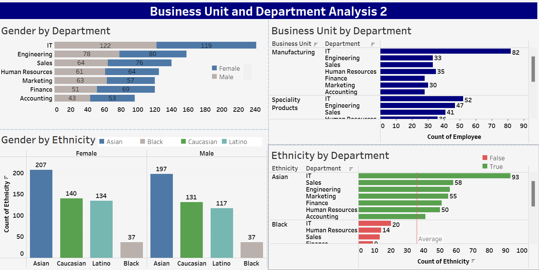
Notes:
IT has the highest number of employees (241) followed by Engineering (158), though both are above the department average of 142
• Four departments with bonuses above the average of 12: Marketing, Human Resources, Finance, and IT
• Specialty Products and Corporate have the highest number of employees, surpassing the average compared to Research & Development and Manufacturing

Slide 10

Gender and Ethnicity Analysis
The analysis reveals a gender distribution of 52% female and 48% male employees. In terms of ethnicity, the workforce is composed of 25% Latino, 40% Asian, 27% Caucasian, and 7% Black employees. Interestingly, the average bonus is highest for employees in Marketing, HR, Finance, and IT departments, regardless of ethnicity.
When examining employee exits, the data shows more females leaving roles in Manufacturing, Specialty Products, and R&D, while more males are exiting Corporate positions. Additionally, the average bonus is higher for female employees compared to their male counterparts.
The number of employees by gender and ethnicity indicates a larger representation of both females and males in the Asian ethnic group, with the least representation in the Black ethnic group.
Notes:
Gender and Ethnicity Analysis:
• Gender distribution: 52% female, 48% male
• Ethnicity breakdown: 25% Latino, 40% Asian, 27% Caucasian, 7% Black
• Gender distribution by department: More females in Manufacturing, Specialty Products, and Research & Development; more males in Corporate
• Bonus distribution: Females received more bonuses than males, with both genders above average
• Ethnicity and bonus: Asians have above-average bonuses, Blacks have the least bonuses, some Latinos and Caucasians have above-average bonuses in IT and Engineering but below average in other departments
• Ethnic representation: 404 Asians, 271 Caucasians, 251 Latinos, 74 Blacks
• Exits by ethnicity: More Asians, Caucasians, and Latinos left the company compared to Blacks
• Country and ethnicity: Employees from Brazil, China, and the United States. United States employees are Asian, Black, Caucasian, and Latino. Latinos are from Brazil, Asians are from China.

Slide 11
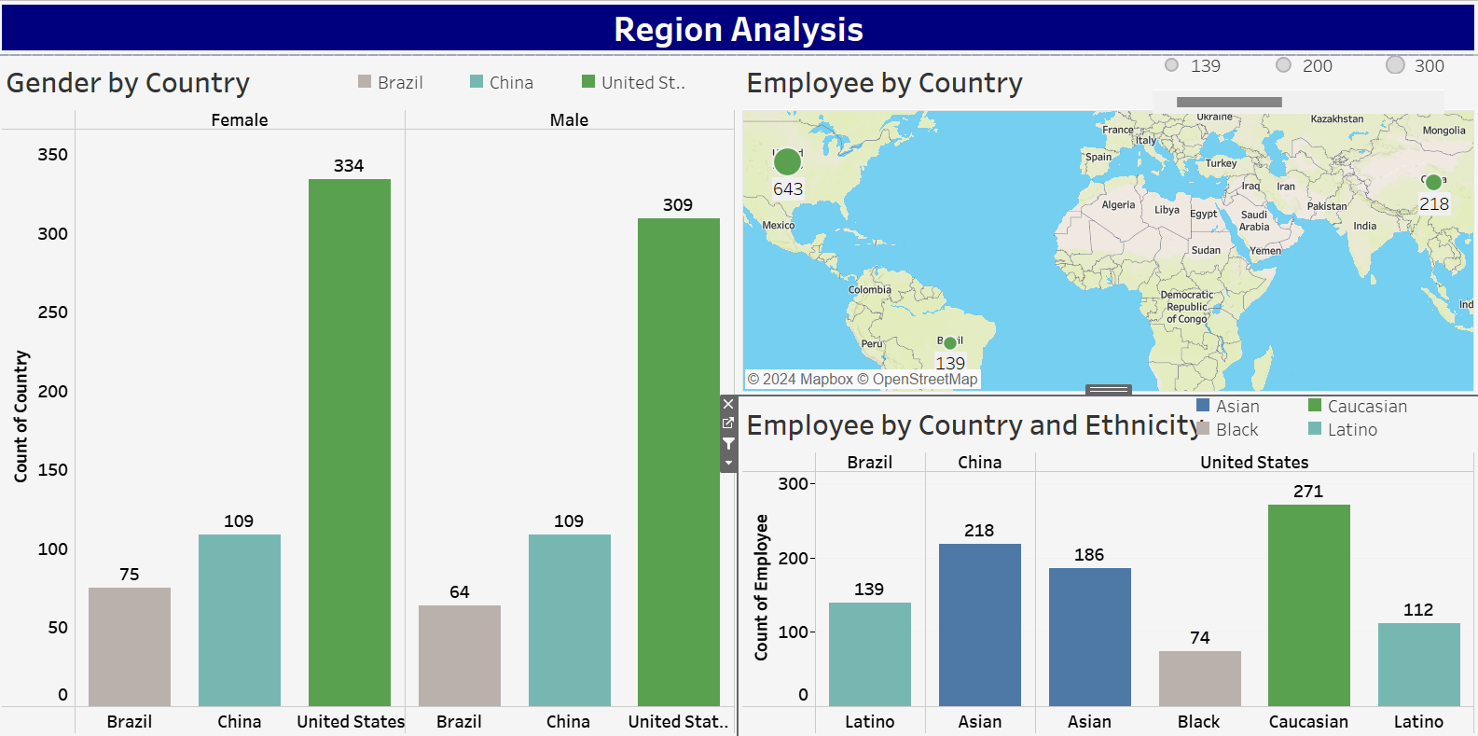
Country and City Analysis
Notes:
The majority of employees are based in the United States, with a significant presence in China, Brazil, India, and Germany, showing a strong global footprint with a focus on major markets.
Employee distribution by country: The United States has a diverse workforce, which includes Asian, Black, Caucasian, and Latino employees;
Brazil has Latino employees; China has Asian employees.

Slide 12
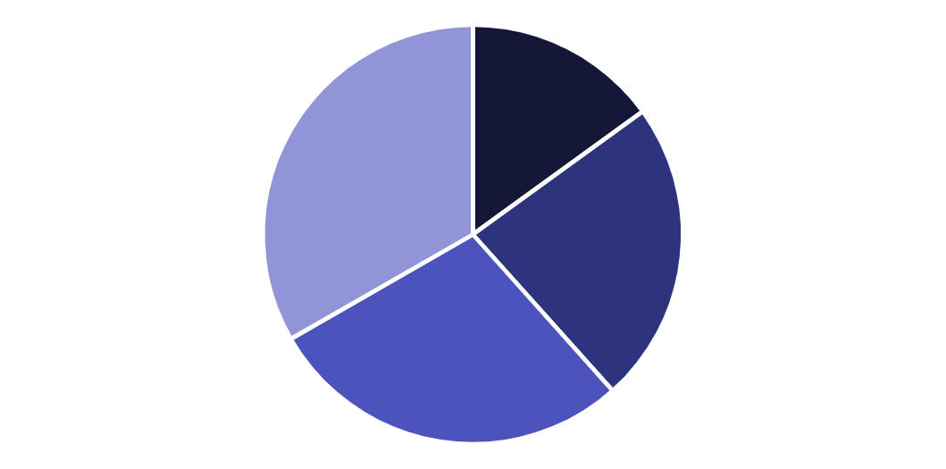
Age Distribution Analysis
The age distribution of the company's employees shows a significant proportion of middle-aged and elderly workers, with 283 middle-aged adults and 333 elderly employees. This suggests the company may need to focus on attracting and retaining younger talent to maintain a balanced workforce.
The average age group across all departments is between 44-46 years old, indicating the company has an experienced but potentially less agile workforce. Strategies to address this, such as mentorship programs or skills training, may be beneficial.
Notes:
Age Distribution Analysis:
• Age groups: 150 Young Adults, 234 Adults, 283 Middle-aged Adults, 333 Elderly
• Elderly employees constitute the largest age group in the company
• Average age group across all departments: 44-46 years

Slide 13

Age Distribution Analysis Cont..
The analysis of the age distribution of employees reveals some interesting insights. The data shows that the majority of the workforce is concentrated in the mid-career range, with a significant number of employees in their 30s and 40s. This suggests a relatively experienced and mature team, which could be beneficial for the organization's stability and knowledge retention.
However, the analysis also highlights the need to consider succession planning and talent development. The relatively low percentage of younger employees may indicate challenges in attracting and retaining early-career talent, which could impact the organization's long-term growth and innovation. Addressing this imbalance could be a key focus area for the HR team.
Notes:
6

Slide 14
Annual Salary and Bonus Analysis
$113,217K
$11,322K
$20K
Average Salary
Average Bonus
Salary Disparity
The average annual salary across all employees is $113,217,.
The average annual bonus is $11,322 per employee.
Latino and Black employees receive on average $20,000 less in salary compared to other ethnicities.
Notes:
• Salary distribution:

Slide 15
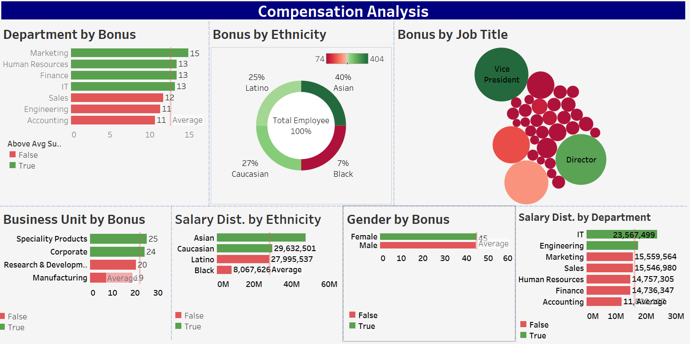
Notes:
Annual Salary and Bonus Analysis:
• Salary distribution: Latinos and Blacks are paid below average compared to other ethnicities
• Bonus eligibility: Only Vice Presidents, Managers, Senior Managers, Directors, and Engineering Managers are entitled to bonuses
• Gender and ethnicity distribution: More male and female Asians in the company, with Blacks being the least represented

Slide 16
Analysis Summary:
• The company has a robust and expanding workforce with significant hiring in recent years, especially in 2021.
• IT and Engineering departments have the highest number of employees, with Human Resources and Finance seeing the highest exit rates.
• Gender distribution is relatively balanced, with a slight female majority, while ethnicity distribution shows a higher representation of Asians and a lower representation of Blacks.
• Age distribution reveals a higher number of Elderly employees, with the average age group between 44-46 years.
• Salary and bonus analyses indicate disparities, with Latinos and Blacks receiving lower average salaries and bonuses.
• Geographic distribution shows a concentration of employees in the United States, followed by Brazil and China.
Notes:
The company has seen significant workforce growth, especially in 2021. IT and Engineering have the most employees, while Human Resources and Finance see high exit rates. There's a balanced gender distribution with a slight female majority. The age group averages 44-46 years. Salary and bonus analyses show disparities, with Latinos and Blacks receiving lower average pay. The majority of employees are based in the United States, followed by Brazil and China.

Slide 17

Limitations Summary
The analysis presented in this report has several limitations that should be considered. The data provided only covers a specific time period and may not reflect long-term trends or patterns. Additionally, the analysis is limited to the information available in the employee records, which may not capture all relevant factors contributing to employee demographics and compensation.
Another limitation is the potential for biases or inaccuracies in the self-reported data, such as gender and ethnicity. The analysis is also constrained by the available data fields and may not provide a comprehensive understanding of the underlying factors driving the observed trends.
Notes:
There are data limitations

Slide 18

Limitations
1
Incomplete Data
2
Geographic Gaps
The analysis is limited by the lack of information on reasons behind employee exits, which restricts understanding of turnover causes. Additionally, the absence of employee feedback or surveys prevents deeper insights into the workforce's perspectives.
While the analysis identifies countries where employees are located, it lacks detailed insights into city-level distributions or regional trends within those countries. The potential impact of geographic location on salary, bonus distribution, or employee satisfaction and retention is not explored.
3
Insufficient Context
The analysis lists job titles and departments but does not provide detailed insights into the specific roles and responsibilities or how they might affect turnover rates, salary, and bonuses. The distinction between voluntary and involuntary exits is also not made, limiting the ability to develop targeted retention strategies.
Notes:
• There is no information on the reasons behind employee exits, which limits understanding of turnover causes.
• While the analysis identifies countries where employees are located, it lacks detailed insights into city-level distributions or regional trends within those countries.
• There is no examination of how geographic location might impact salary, bonus distribution, or employee satisfaction and retention.
• The salary and bonus analysis highlights disparities but does not explore potential reasons or provide recommendations for addressing these issues.
• The analysis lists job titles and departments but does not provide detailed insights into the specific roles and responsibilities or how they might affect turnover rates, salary, and bonuses.
• There is no mention of employee feedback or surveys that could provide deeper insights into the workforce's perspectives.
• The reasons behind employee exits are not explored, which limits the ability to develop targeted retention strategies.
• There is no distinction between voluntary and involuntary exits, which could provide more nuanced insights into turnover trends.

Slide 19
Recommendations
• Investigate factors contributing to high exits in specific departments and develop retention strategies.
• Address salary and bonus disparities to ensure equitable compensation across all ethnic groups.
• Continue expanding hiring efforts while monitoring and supporting employee demographics to maintain diversity and inclusion.
• Focus on understanding the high turnover in 2021 to mitigate future exit spikes and sustain company growth.
Notes:
• Investigate factors contributing to high exits in specific departments and develop retention strategies.
• Address salary and bonus disparities to ensure equitable compensation across all ethnic groups.
• Continue expanding hiring efforts while monitoring and supporting employee demographics to maintain diversity and inclusion.
• Focus on understanding the high turnover in 2021 to mitigate future exit spikes and sustain company growth.

Slide 20
Whats Next?
1. Investigate High Exits in Specific Departments:
2. Address Salary and Bonus Disparities
3. Continue Expanding Hiring with Diverse Demographics
4. Understand High Turnover in 2021:
Notes:
1. Investigate High Exits in Specific Departments:
• Conduct Exit Interviews
• Analyze Exit Data
• Focus GroupDiscussions
• Review Management Practices
2. Address Salary and Bonus Disparities:
• Compensation Review
• Pay Equity Analysis
• Adjust Compensation
3. Continue Expanding Hiring with Diverse Demographics:
• Diversity and Inclusion Initiatives
• Diversity Recruiting Strategies
• Track Hiring Demographics
4. Understand High Turnover in 2021:
• Identify Specific Triggers
• Compare to Industry Standards
• Review Company Culture

Slide 21


Thank You
Continued Collaboration
Gratitude Expressed
We would like to express our sincere gratitude for your time and attention throughout this presentation. Your valuable insights and feedback have been instrumental in shaping our recommendations and ensuring they align with your organization's needs.
We look forward to the opportunity to continue working together and implementing the strategies we have discussed. Your trust and support are greatly appreciated, and we are committed to delivering the best possible outcomes for your organization.
Notes:
Thank you

